Slide 1
How to iOS device on MacOS through Intune?
Doc: TBD

Slide 2
Use Case: Prevent iOS except approved specific media
Prevent all access to all but allow
enduser to backup and update specific iOS device with local machine
enduser to download file(s) and photo(s) and sync and backup and update from the specific iOS device to local machine
Notes:
{36fc9e60-c465-11cf-8056-444553540000}
{88BAE032-5A81-49f0-BC3D-A4FF138216D6}

Slide 3
Step 1: Enable Device control and set Default Enforcement
Design and have right default enforcement setting in your organization.
You will need to use this setting in step 10 below.
"settings":{
"features":{
"appleDevice":{
"disable":false
}
},
"global":{
"defaultEnforcement":"deny"
},
"ux":{
"navigationTarget":"http://www.microsoft.com"
}
}

Slide 4
Step 2: Create any iOS device group
Create an iOS device group representing any iOS device.
This same group can be used in multiple policies.
{
"id":"cb2a7864-0b0d-4951-a628-ac09259ca0a2",
"name":"All Apple devices",
"query":{
"$type":"all",
"clauses":[
{
"$type":"primaryId",
"value":"apple_devices"
}
]
}
}

Slide 5
Step 3: Create a group for allowed-backup/update iOS devices
Create a group which enduser can backup and update.
{
"id":"34aec8e5-e2fa-4d1e-8788-2b1284226653",
"name":"Allow-backup devices",
"query":{
"$type":"any",
"clauses":[
{
"$type":"vendorId",
"value":"1234"
},
{
"$type":"serialNumber",
"value":"ABCDEFGHIJKLMNOP"
}
]
}
}
Notes:
{36fc9e60-c465-11cf-8056-444553540000}
{88BAE032-5A81-49f0-BC3D-A4FF138216D6}

Slide 6
Step 4: Create another group for full-access iOS devices
Create a group which enduser can have full access, e.g. download file(s) and photo(s) and sync and backup and update from the specific iOS device to local machine.
{
"id":"03f025f6-ee9d-49b2-b192-fc7a00df6856",
"name":"Allow-full-access devices",
"query":{
"$type":"any",
"clauses":[
{
"$type":"vendorId",
"value":"1234"
}, {
"$type":"productId",
"value":"ABCD"
},
{
"$type":"serialNumber",
"value":"ABCDEFGHIJKLMNOP"
}
]
}
}
Notes:
{36fc9e60-c465-11cf-8056-444553540000}
{88BAE032-5A81-49f0-BC3D-A4FF138216D6}

Slide 7
Step 5: Create Audit policy for the Default Deny
Create a policy to audit Default Enforcement/Deny set in Step 1.
Keep in mind, use the right Group.
{
"id":"772cef80-229f-48b4-bd17-a6913009298d",
"name":"Block Apple devices",
"includeGroups":[
"cb2a7864-0b0d-4951-a628-ac09259ca0a2"
],
"excludeGroups":[
"34aec8e5-e2fa-4d1e-8788-2b1284226653",
"03f025f6-ee9d-49b2-b192-fc7a00df6856"
],
"entries":[ {
"$type":"appleDevice",
"enforcement":{
"$type":"auditDeny",
"options":[
"send_event",
"show_notification"
] },
"access":[
"download_files_from_device",
"sync_content_to_device",
"backup_device",
"update_device",
"download_photos_from_device"
] } ]
}

Slide 8
Step 6: Create policy for the allowed-backup/update iOS devices
Create a policy to audit Default Enforcement/Deny set in Step 1.
Keep in mind, use the right Group.
{
"id":"bfabe24b-37a6-4bc0-9778-421aeaeece23",
"name":"Allow backup",
"includeGroups":[
"34aec8e5-e2fa-4d1e-8788-2b1284226653"
],
"excludeGroups":[
"03f025f6-ee9d-49b2-b192-fc7a00df6856"
],
"entries":[
{
"$type":"appleDevice",
"enforcement":{
"$type":"auditDeny",
"options":[
"send_event",
"show_notification"
]
},
"access":[
"download_files_from_device",
"sync_content_to_device",
"download_photos_from_device"
]
},
{
"$type":"appleDevice",
"enforcement":{
"$type":"allow"
},
"access":[
"backup_device",
"update_device"
]
},
{
"$type":"appleDevice",
"enforcement":{
"$type":"auditAllow",
"options":[
"send_event"
]
},
"access":[
"backup_device",
"update_device"
]
}
]
}

Slide 9
Step 7: Create policy for the allowed-full-access iOS devices
Create a policy to audit Default Enforcement/Deny set in Step 1.
Keep in mind, use the right Group.
{
"id":"afd5b180-f62e-462f-a319-a4add5a7b391",
"name":"Allow full access",
"includeGroups":[
"03f025f6-ee9d-49b2-b192-fc7a00df6856"
],
"entries":[
{
"$type":"appleDevice",
"enforcement":{
"$type":"allow"
},
"access":[
"download_files_from_device",
"sync_content_to_device",
"backup_device",
"update_device",
"download_photos_from_device"
]
},
{
"$type":"appleDevice",
"enforcement":{
"$type":"auditAllow",
"options":[
"send_event"
]
},
"access":[
"download_files_from_device",
"sync_content_to_device",
"backup_device",
"update_device",
"download_photos_from_device"
]
}
]
}

Slide 10
Step 8: Combines all of above three groups into one ‘groups’
Combines the three groups created in step 2/3/4.
"groups":[
{
"id":"cb2a7864-0b0d-4951-a628-ac09259ca0a2",
"name":"All Apple devices",
"query":{
"$type":"all",
"clauses":[
{
"$type":"primaryId",
"value":"apple_devices"
} ] }
}, {
"id":"34aec8e5-e2fa-4d1e-8788-2b1284226653",
"name":"Allow-backup devices",
"query":{
"$type":"any",
"clauses":[
{
"$type":"vendorId",
"value":"1234"
}, {
"$type":"serialNumber",
"value":"ABCDEFGHIJKLMNOP"
} ] }
},
{
"id":"03f025f6-ee9d-49b2-b192-fc7a00df6856",
"name":"Allow-full-access devices",
"query":{
"$type":"any",
"clauses":[
{
"$type":"vendorId",
"value":"1234"
},
{
"$type":"productId",
"value":"ABCD"
},
{
"$type":"serialNumber",
"value":"ABCDEFGHIJKLMNOP"
}
]
}
}
]

Slide 11
Step 9: Combines all of above three policies into one ‘rules’
Combines the three groups created in step 5/6/7.
"rules":[
{
"id":"772cef80-229f-48b4-bd17-a6913009298d",
"name":"Block Apple devices",
"includeGroups":[
"cb2a7864-0b0d-4951-a628-ac09259ca0a2" ],
"excludeGroups":[
"34aec8e5-e2fa-4d1e-8788-2b1284226653",
"03f025f6-ee9d-49b2-b192-fc7a00df6856" ], "entries":[…]
},
{
"id":"bfabe24b-37a6-4bc0-9778-421aeaeece23",
"name":"Allow backup",
"includeGroups":[
"34aec8e5-e2fa-4d1e-8788-2b1284226653" ],
"excludeGroups":[
"03f025f6-ee9d-49b2-b192-fc7a00df6856" ], "entries":[..]
},
{
"id":"afd5b180-f62e-462f-a319-a4add5a7b391",
"name":"Allow full access",
"includeGroups":[
"03f025f6-ee9d-49b2-b192-fc7a00df6856" ], "entries":[…]
}
]

Slide 12
Step 10: Create Policy to allow the approved USB Group
Now, you have ‘groups’ and ‘rules’ and ‘settings’, replace the mobileconfig file with those values and put it under the device control node. You can download here: mdatp-devicecontrol/demo.mobileconfig at main · microsoft/mdatp-devicecontrol (github.com)
Notes:
{36fc9e60-c465-11cf-8056-444553540000}
{88BAE032-5A81-49f0-BC3D-A4FF138216D6}

Slide 13
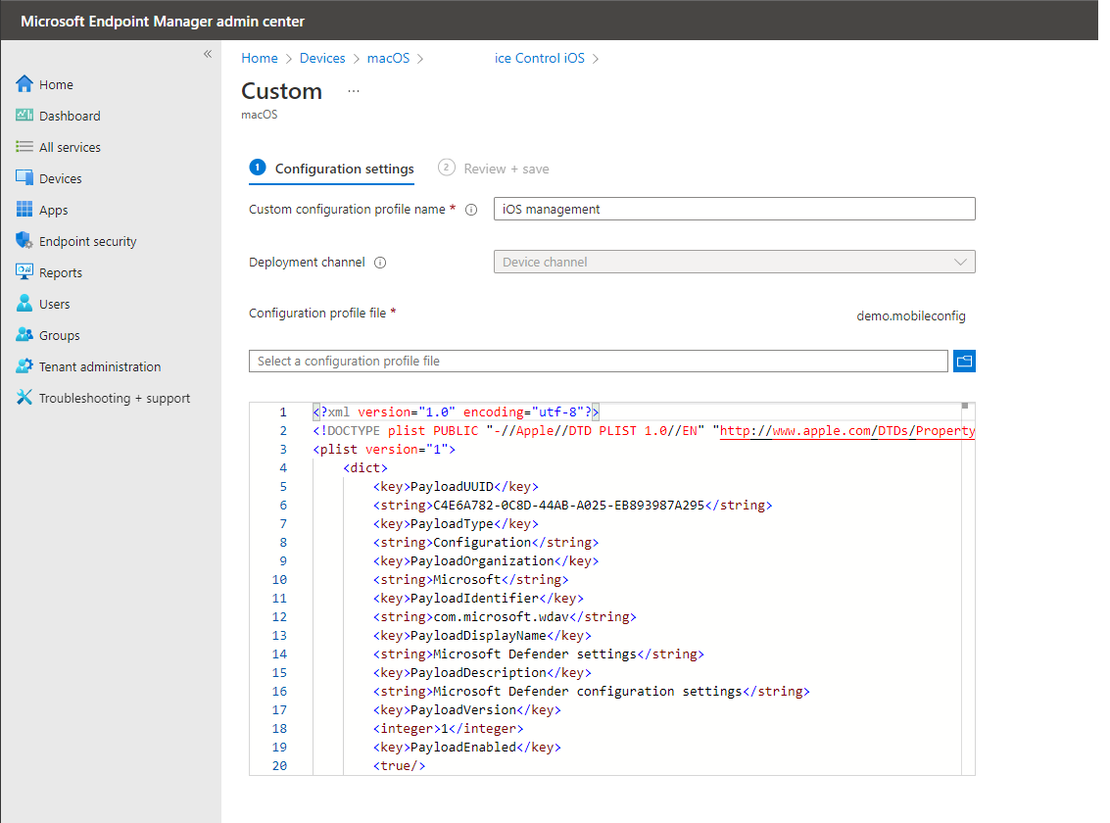
Step 11: Create Policy to allow the approved USB Group
You can deploy the mobileconfig file through https://endpoint.microsoft.com/ -> Devices -> macOS:
select ‘Create profile’
select ‘Templates’ and ‘Custom’
Notes:
{36fc9e60-c465-11cf-8056-444553540000}
{88BAE032-5A81-49f0-BC3D-A4FF138216D6}

Slide 14
Enduser Experience

Slide 15
Audit/Allow mode
There is no notification on the client side, but in the backend the system will fire event for reporting

Slide 16
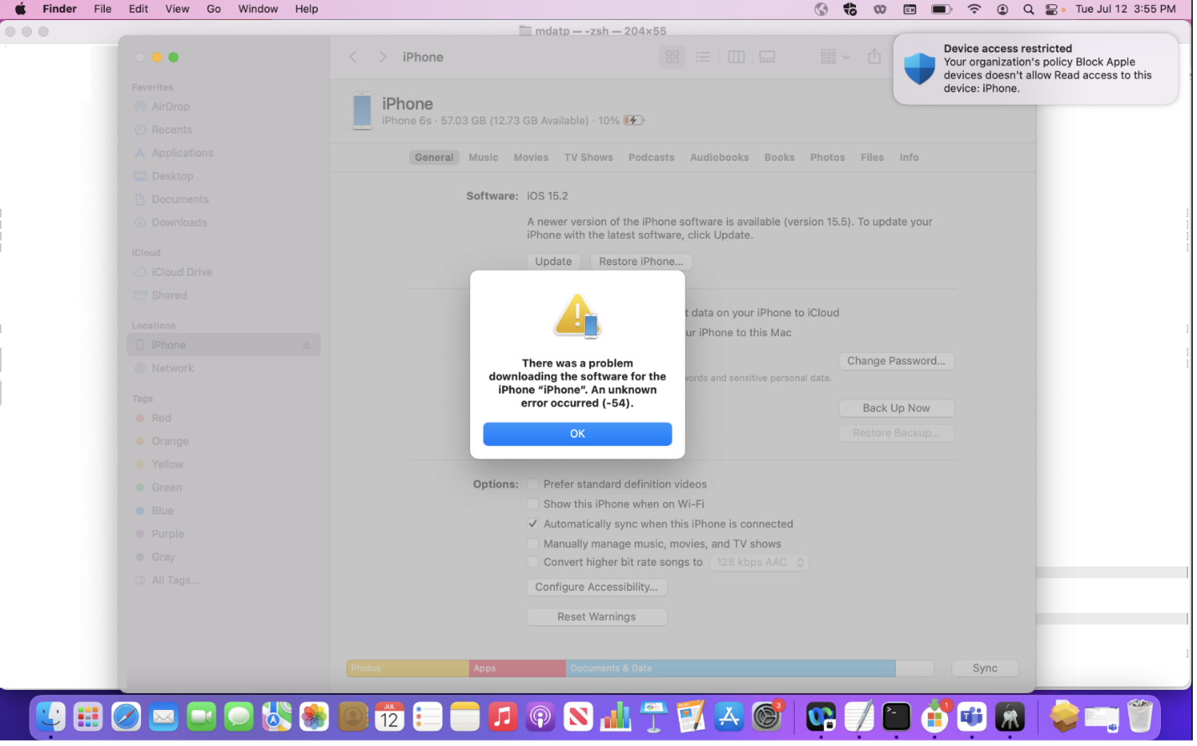
Block mode
Once Deny happens, you will see a toast on the right top corner.

Slide 17
Reporting

Slide 18
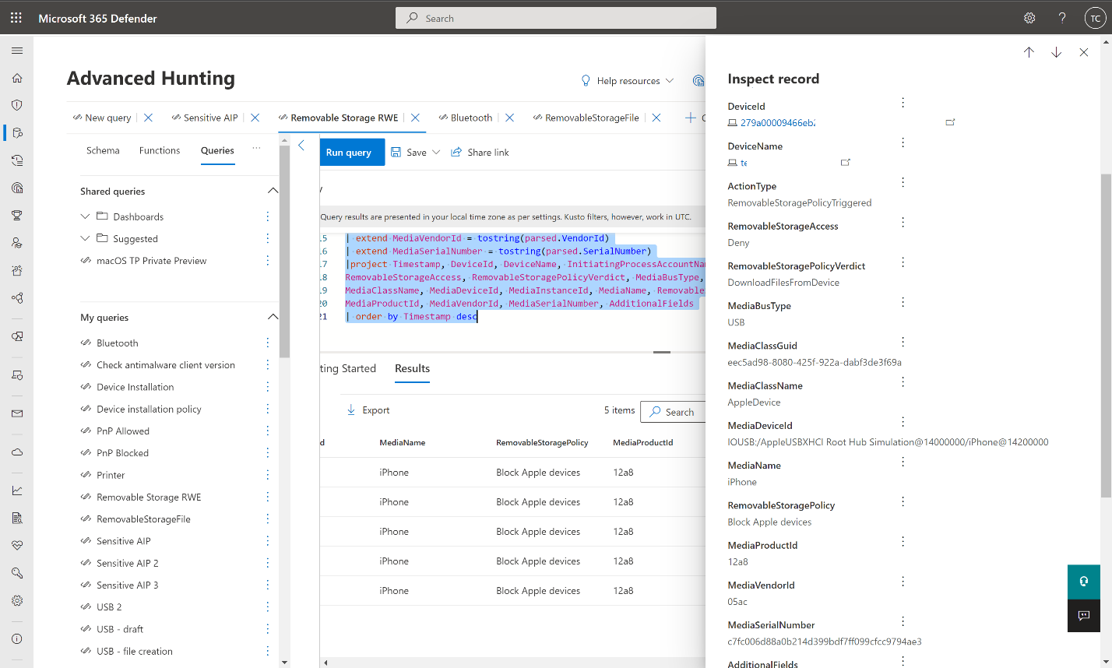
Advanced hunting
There is no notification on the client side, but in the backend the system will fire event for reporting
//RemovableStoragePolicyTriggered: event triggered by Disk level enforcement
DeviceEvents
| where ActionType == "RemovableStoragePolicyTriggered"
| extend parsed=parse_json(AdditionalFields)
| extend RemovableStorageAccess = tostring(parsed.RemovableStorageAccess)
| extend RemovableStoragePolicyVerdict = tostring(parsed.RemovableStoragePolicyVerdict)
| extend MediaBusType = tostring(parsed.BusType)
| extend MediaClassGuid = tostring(parsed.ClassGuid)
| extend MediaClassName = tostring(parsed.ClassName)
| extend MediaDeviceId = tostring(parsed.DeviceId)
| extend MediaInstanceId = tostring(parsed.DeviceInstanceId)
| extend MediaName = tostring(parsed.MediaName)
| extend RemovableStoragePolicy = tostring(parsed.RemovableStoragePolicy)
| extend MediaProductId = tostring(parsed.ProductId)
| extend MediaVendorId = tostring(parsed.VendorId)
| extend MediaSerialNumber = tostring(parsed.SerialNumber)
|project Timestamp, DeviceId, DeviceName, InitiatingProcessAccountName, ActionType,
RemovableStorageAccess, RemovableStoragePolicyVerdict, MediaBusType, MediaClassGuid,
MediaClassName, MediaDeviceId, MediaInstanceId, MediaName, RemovableStoragePolicy,
MediaProductId, MediaVendorId, MediaSerialNumber, AdditionalFields
| order by Timestamp desc

Slide 19
End

